Slide 1

Statics Members and Operators
Variable Number Arguments
Default Values
Operator Overloading
Static Members

Slide 2

See Also
https://www.tutorialspoint.com/cplusplus/cpp_overloading.htm
https://www.youtube.com/watch?v=qRCEdWQ0f4Q
Notes:
Here is some additional reading on the web.

Slide 3

Argument Magic (varargs)
int addAll2(int ... values) {
System.out.println(values.length);
return values[0];
}
int addAll(int [] values) {
System.out.println(values.length);
return values[0];
}
addAll2(1,2,3,4);
int [] vals = {1,2,3,4};
addAll(vals);
Java
int addAll(int n, ...) {
va_list vl;
va_start(vl, n);
int first = va_arg(vl, int);
int second = va_arg(vl, int);
va_end(vl);
return first;
}
int x = addAll(1, 2, 3, 4);
C++
template<class... Args>
void print(Args... args)
{
(std::cout << ... << args) << "\n";
}
print(1, ':', " Hello", ',', " ", "World!");
C++ 17
def addAll(*args,**kwargs):
print(type(args),args)
print(type(kwargs),kwargs)
addAll(1,2,3,name='chris',cool='yes')
Python
<class 'tuple'> (1, 2, 3)
<class 'dict'> {'name': 'chris', 'cool': 'yes'}
Notes:
Variadic templates

Slide 4
Argument Magic (default values)
class Point {
int x;
int y;
string color;
public:
Point(int x, int y, string color = "blue") {
this->x = x;
this->y = y;
this->color = color;
}
};
Point * x = new Point(2, 3);
Point * y = new Point(2, 3, "red");
C++
Python
class Point:
def __init__(self,color,x=0,y=0):
self._color = color
self._x = x
self._y = y
a = Point('Red')
b = Point('Blue',5)
c = Point('Green',y=2)
d = Point('Pink',3,4)
_color=‘Red’, _x=0, _y=0
_color=‘Blue’, _x=5, _y=0
_color=‘Green’, _x=0, _y=2
_color=‘Pink’, _x=3, _y=4
Notes:
Not Java … Java we use overloading

Slide 5
Function Overloading (C++ and Java)
class Point {
void sayHi(string name) {
cout << "string " << name << endl;
}
int sayHi(int x) {
cout << "int " << x << endl;
return 0;
}
int sayHi(long int y) {
cout << "long " << y << endl;
return 0;
}
void sayHi(int x, int y) {
cout << "two " << x << "," << y << endl;
}
};
C++
p->sayHi("topher");
p->sayHi(20);
p->sayHi(20L);
p->sayHi(20, 30);
C++
Return type and Exception list doesn’t count
Compiler will do its best
Use casts to be explicit
Notes:
Not python. Python keeps members in a dictionary … just one name (key) allowed.

Slide 6
Operator Overloading (C++)
class Point {
public:
Point addValueToXandY(int value) {
Point ret(this->x + value, this->y + value);
return ret;
}
Point operator+(int value) {
Point ret(this->x + value, this->y + value);
return ret;
}
bool operator==(Point other) {
if (other.x == x && other.y == y) {
return true;
}
return false;
}
};
C++
Point a(1, 2);
Point b = a.addValueToXandY(6);
cout << b.getX() << endl;
Point c = a + 6;
cout << (c == b) << endl;
C++

Slide 7
Operator Overloading (Python)
class Point:
def add_to_x_y(self,value):
ret = Point(self._x+value,self._y+value)
return ret
def __add__(self,value):
ret = Point(self._x+value,self._y+value)
return ret
def __eq__(self,other):
if other._x == self._x and other._y == self._y:
return True
return False
def __setitem__(self,ind,value):
self._x = ind
self._y = value
Python
Python
a = Point(1,2)
b = a.add_to_x_y(5)
c = a + 5
print(b == c)
a[24] = 30
print(a.get_x(),a.get_y())
FALSE
TRUE

Slide 8
Operator Overloading (Java)
public class Point {
public boolean equals(Point other) {
if(other.x ==x && other.y == y) {
return true;
}
return false;
}
}
String x = "Hello" + "World";
Point a = new Point(1,2);
Point b = new Point(1,2);
if(a==b) {System.out.println("YES?");}
if(a.equals(b)) {System.out.println("YEEESSSS");}
Java
Notes:
Just strings in Java … the compiler does the changing because it knows about String.
“equals” is the agreed upon method name (it’s in the baseclass of object)

Slide 9
Static Members (Java)
System.out.println("HERE");
System.out.println(Point.getNumCreated());
Point a = new Point();
Point b = new Point();
Point c = new Point();
System.out.println(Point.getNumCreated());
Java
class Point {
static private int numCreated = 0;
public static int getNumCreated() {
return Point.numCreated;
}
public Point() {
Point.numCreated = Point.numCreated + 1;
System.out.println(Point.numCreated);
}
}
Java
HERE
0
1
2
3
3

Slide 10
Static Members (C++)
class Point {
static int numCreated;
public:
static int getNumCreated() {
return Point::numCreated;
}
Point() {
Point::numCreated = Point::numCreated + 1;
cout << Point::numCreated << endl;
}
};
int Point::numCreated = 0;
cout << Point::getNumCreated() << endl;
Point * a = new Point();
Point * b = new Point();
Point * c = new Point();
cout << Point::getNumCreated() << endl;
C++
0
1
2
3
3

Slide 11
Static Members (Python)
class Point:
_num_created = 0
print('Class loaded')
def get_num_created():
return Point._num_created
def __init__(self):
Point._num_created += 1
print(Point._num_created)
print('HERE')
print(Point.get_num_created())
a = Point()
b = Point()
c = Point()
print(Point.get_num_created())
Python
Class loaded
HERE
0
1
2
3
3

Slide 12
Alternate Syntax
class Point {
static private int numCreated = 0;
public static int getNumCreated() {
return Point.numCreated;
}
public Point() {
System.out.println(numCreated);
this.numCreated += 1;
}
}
System.out.println(Point.getNumCreated());
Point a = new Point();
System.out.println(a.getNumCreated());
class Point:
_num_created = 0
print('Class loaded')
@staticmethod
def get_num_created():
return Point._num_created
def __init__(self):
Point._num_created += 1
print(self._num_created)
print('HERE')
print(Point.get_num_created())
a = Point()
print(a._num_created)
print(a.get_num_created())
The static field Point.numCreated should be accessed in a static way
TypeError: get_num_created() takes 0 positional arguments but 1 was given
Notes:
Might confuse you. I always use the “Class.” syntax to keep it straight in my head.
My recommendation: for static members, use the name of the class!

Slide 13
Alternate Syntax
class Point {
static int numCreated;
public:
static int getNumCreated() {
return Point::numCreated;
}
Point() {
numCreated = numCreated + 1;
this->numCreated = this->numCreated + 1;
cout << this->numCreated << endl;
}
};
int Point::numCreated = 0;
cout << Point::getNumCreated() << endl;
Point * a = new Point();
cout << a->getNumCreated() << endl;
C++

Slide 14
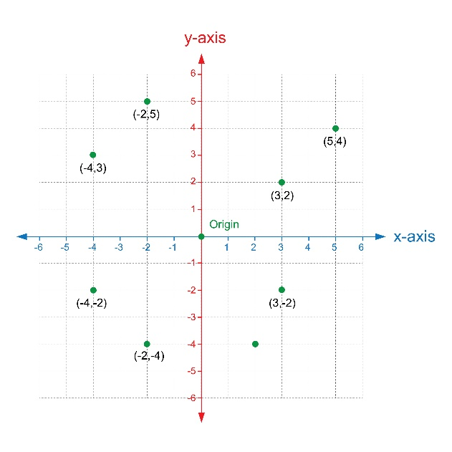
Tinkering
Add a static member to Point to count the number of Point object that have been created.
Provide a public static get method for the count.
Use Python or C++ to overload the “-” operator. The method should return the (float) distance between the two points as in:
f = p1 - p2
Notes:
Here are a couple of things to think about and/or try. This is totally optional … nothing for you to send to me.

